Slide 1
AI-Driven Smart CCTV Surveillance System with Real-Time Detection and Facial Recognition Using Python and OpenCV

Slide 2
Abstract
The rapid growth of AI and computer vision has revolutionized surveillance with intelligent systems capable of real-time threat detection and facial recognition. This project leverages Python, OpenCV, and machine learning to develop a smart CCTV system that enhances security through anomaly detection and advanced analytics.
Using state-of-the-art models like YOLO and TensorFlow, it achieves high-accuracy object and behavior recognition. The system is designed for diverse applications, from public safety to retail monitoring, ensuring robust, scalable, and efficient security solutions. This innovation represents a vital tool for modern safety in a complex world.

Slide 3
Introduction
The integration of artificial intelligence (AI) and computer vision has transformed traditional surveillance systems into intelligent, proactive security solutions. This project focuses on developing a smart CCTV system using Python, OpenCV, and machine learning to enable real-time anomaly detection and facial recognition.
By leveraging advanced algorithms, the system ensures accurate threat identification and efficient monitoring. Designed for scalability and versatility, it addresses diverse applications like public safety, traffic control, and retail analytics. This innovation redefines security, offering a robust and adaptive approach to modern surveillance needs.

Slide 4
Existing System
Existing surveillance systems primarily rely on traditional CCTV setups that passively record video footage for later review, lacking real-time threat detection capabilities. These systems often depend on manual monitoring, which is prone to human error and inefficiency. While some advanced setups incorporate basic motion detection, they lack the integration of AI-driven features like anomaly detection and facial recognition. Limited scalability and high storage requirements further hinder their effectiveness in dynamic environments. Overall, current systems fail to provide proactive, automated responses to potential threats.

Slide 5
Proposed System
The proposed system is an AI-powered smart CCTV solution that integrates real-time anomaly detection, facial recognition, and object tracking using Python, OpenCV, and machine learning. It leverages advanced algorithms like YOLO and TensorFlow to identify security threats with high accuracy and efficiency.
The system is designed to provide automated alerts, scalability, and adaptability across various environments. By replacing manual monitoring with intelligent analytics, it ensures proactive and reliable surveillance. This solution aims to enhance public safety and operational efficiency while addressing the limitations of traditional systems.

Slide 6
LITERATURE REVIEW
The literature highlights the evolution of surveillance systems, emphasizing the integration of artificial intelligence and machine learning for enhanced functionality. Studies demonstrate the effectiveness of using Python and OpenCV for tasks like object detection, facial recognition, and anomaly detection. Techniques such as YOLO, Haar cascades, and deep learning frameworks like TensorFlow have proven critical for real-time analysis. Challenges like privacy concerns, scalability, and false positives are common themes in existing research. These insights underscore the need for intelligent, adaptive systems to address the growing demands of modern security applications.

Slide 7
Module
1.Motion Detection Module:
Detects and tracks motion within the video feed.
Filters out noise and identifies moving objects in real-time.
2.Facial Recognition Module:
Identifies and verifies faces using a pre-trained model.
Implements algorithms like LBPH (Local Binary Pattern Histograms) for accurate recognition.

Slide 8
3. Object Detection Module:
Identifies and classifies objects such as people, vehicles, or suspicious items.
Supports integration with YOLO (You Only Look Once) and SSD (Single Shot Detector) models.
4. Visitor Counting Module (in out Monitor):
Tracks the number of people entering and exiting a monitored area for crowd management.

Slide 9
Algorithms Used in the System:
1.YOLO (You Only Look Once):
A real-time object detection algorithm that divides an image into a grid and predicts bounding boxes and class probabilities simultaneously.
Known for its speed and high accuracy in detecting objects.
2. Haar Cascade Classifiers:
Used for face detection by identifying patterns in the image.
Based on pre-trained cascades for facial features.
3. LBPH (Local Binary Pattern Histogram):
Employed for facial recognition by extracting unique facial features and comparing them with stored data.

Slide 10
Algorithms Used in the System:
4.Structural Similarity Index (SSIM):
Measures the similarity between two video frames for motion detection.
Useful for identifying subtle differences in frames caused by motion.
5.Deep Learning Frameworks:
TensorFlow/PyTorch: Used to train and deploy neural networks for tasks like anomaly detection and feature extraction.
Supports custom model training for domain-specific requirements.
6.Background Subtraction:
A method for detecting motion by comparing the current frame to a reference (background) frame.

Slide 11
Software Components:
YOLO (You Only Look Once)
OpenCV
Roboflow
PyTorch
Matplotlib
NumPy
Hydra
Hardware Components:
Camera/Camera Module
GPU (Graphics Processing Unit)
CPU (Central Processing Unit)
RAM (Random Access Memory)
Storage
Edge Device (Optional)
Power Supply

Slide 12
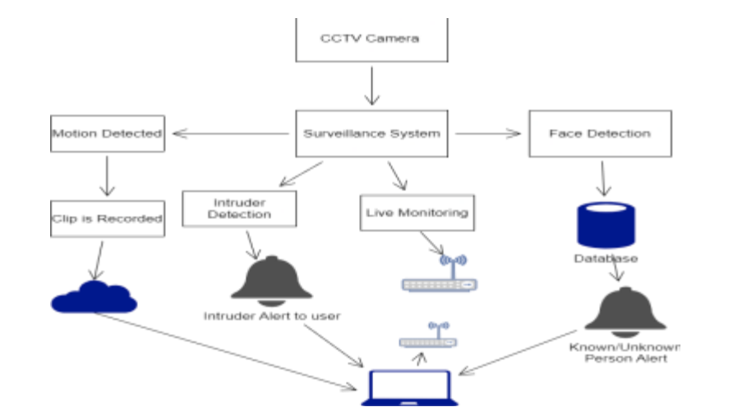
Block Diagram

Slide 13
UML Diagrams
Use Case Diagram
Data Flow Diagram
Sequence Diagram
State Diagram

Slide 14
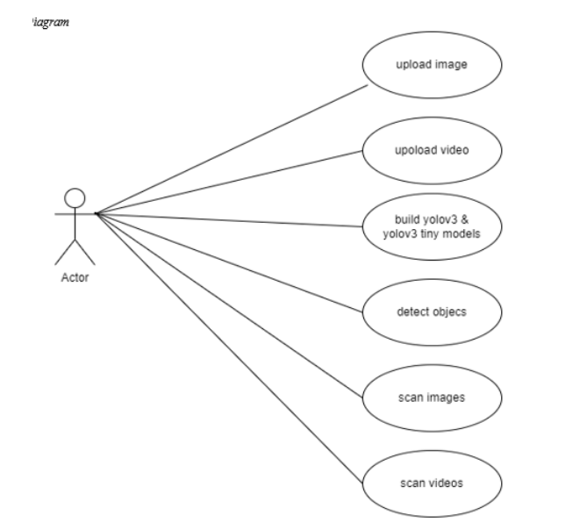
Usecase Diagrams

Slide 15
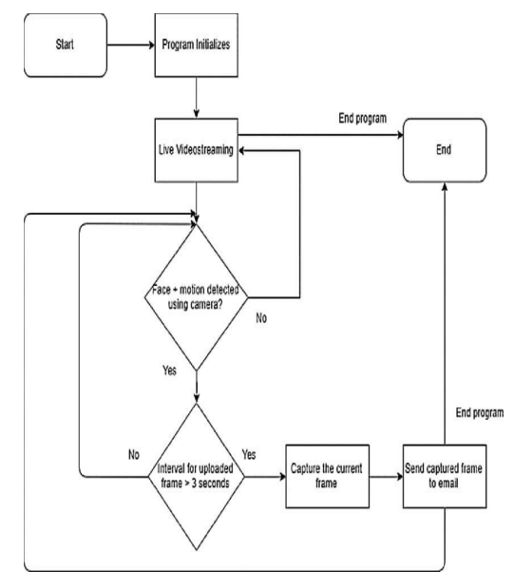
Data Flow Diagrams

Slide 16
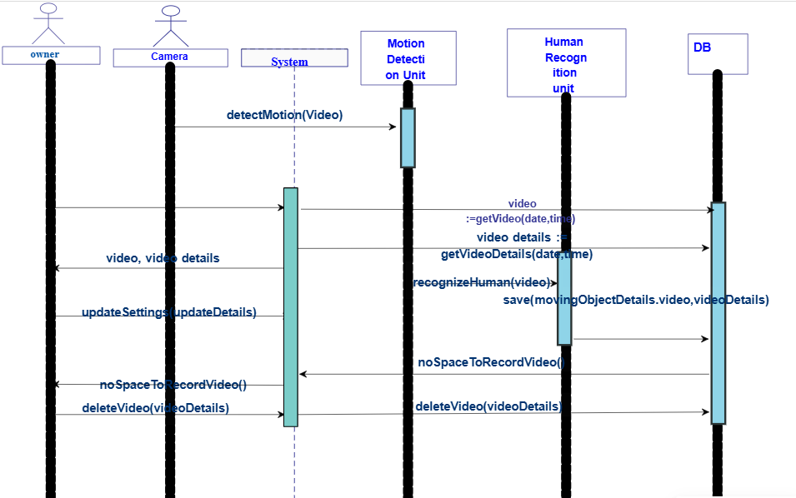
Sequance Diagrams

Slide 17
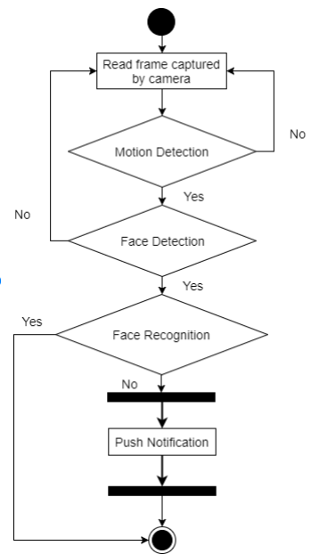
Active Diagrams

Slide 18
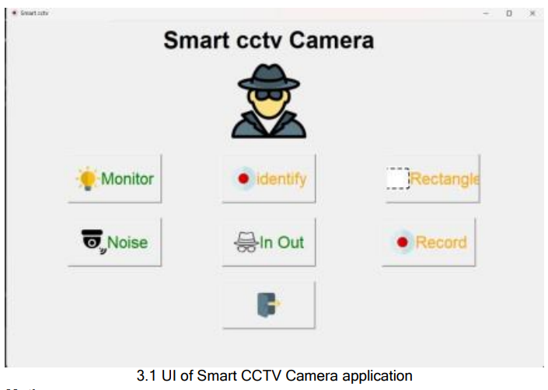
Final Output
The results and analysis section evaluates the performance, functionality, and impact of the Smart CCTV Surveillance System Using Python. It highlights the key outcomes derived from the implementation, testing, and evaluation phases while analyzing the system's efficiency and effectiveness.

Slide 19
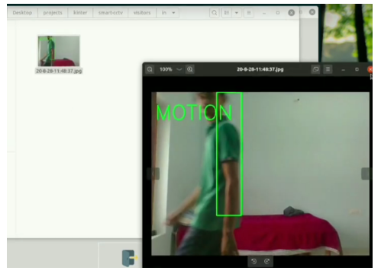
Final Output
In out Detection

Slide 20
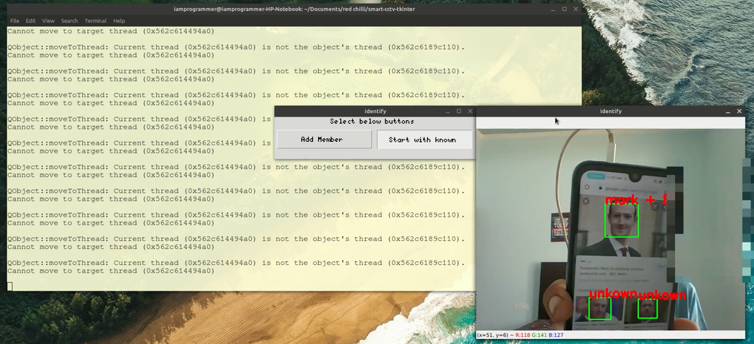
Final Output
Face Recognition

Slide 21
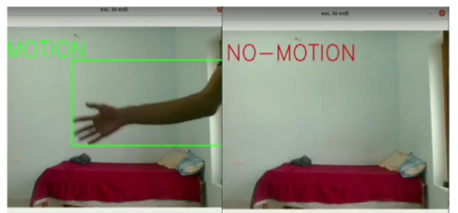
Final Output
Noise Detection

Slide 22
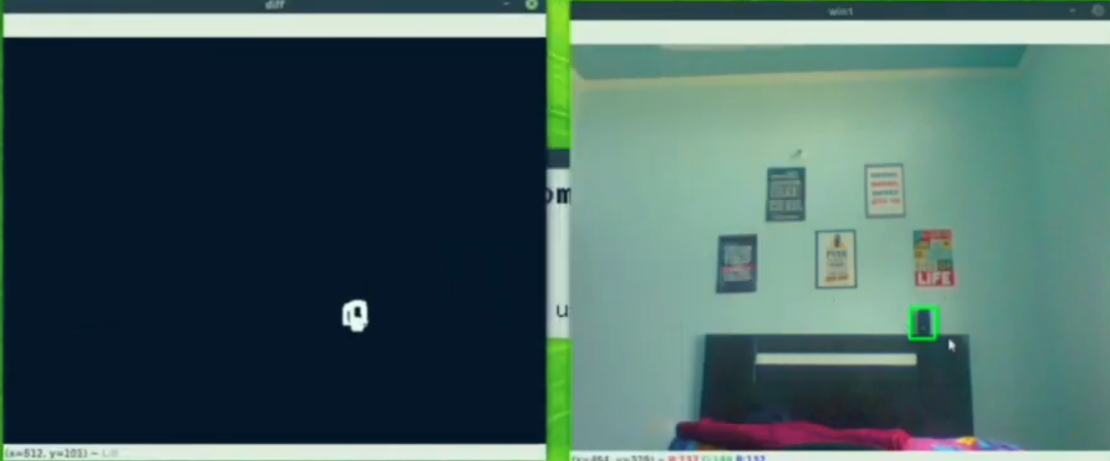
Final Output
Monitor

Slide 23
Conclusion
In conclusion, the smart CCTV surveillance system developed using Python and OpenCV demonstrates significant advancements in enhancing security and public safety. With features like real-time object detection, face recognition, and intruder alerts, it provides proactive threat identification and swift response capabilities. The system’s ability to learn from past events and its modular design ensure adaptability and scalability across various environments. By automating surveillance tasks, it offers improved efficiency over traditional systems. This innovation represents a robust, intelligent solution for modern security challenges.

